Slide 1

The Comparison of Local and Global Fake News Detection Methods - survey
Maciej Pawlikowski, Hubert Ruczyński,
Bartosz Siński, Adrian Stańdo

Slide 2
01
Related Papers
Topic detection,
Fake news Detection
Explainability

Slide 3
Literature Review
Title | Topic | Authors | Description
Topic detection with recursive consensus clustering and semantic enrichment | Topic Detection | Vincenzo De Leo, Michelangelo Puliga, Marco Bardazzi, Filippo Capriotti, Andrea Filetti, Alessandro Chessa | Presents opportunities and challenges considering the topic detection in Twitter debates. It suggests a framework with stable clustering based on Non-Negative Matrix Factorization (NMF), and semantical enrichment of short messages.
Clustering and topic modeling over tweets: A comparison over a health dataset | Topic Detection | Juan Antonio Lossio-Ventura, Juandiego Morzan, Hugo Alatrista-Salas, Tina Hernandez-Boussard, Jiang Bian | Introduces a framework for topic detection in Twitter debates. It shows how to evaluate clusterings with the Calinski-Harabasz index, and the Silhouette Coefficient, and it uses those metrics to compare the efficiency of various LDA approaches to topic modeling.
Improving Fake News Detection Using K-means and Support Vector Machine Approaches | Fake News Detection | Kasra Majbouri Yazdi, Adel Majbouri Yazdi, Saeid Khodayi, Jingyu Hou, Wanlei Zhou, Saeed Saedy | Describes the importance of feature selection in fake news detection. Authors propose a method-based K-means and SVM outperforming state-of-the-art techniques.

Slide 4
Literature Review
Title | Topic | Authors | Description
Fake News Detection using Machine Learning with Feature Selection | Fake News Detection | Z. Tian. S. Baskiyar | The paper proposes a fake news detection system using KNN and utilizing Genetic and Evolutionary Features Selection. Additionally, the authors test the viability of the quantum version of KNN (QKNN)
A systematic survey on explainable AI applied to fake news detection | Explainability | Athira A.B., S.D. Madhu Kumar, Anu Mary Chacko | The survey covers fake news detection models that use explainable AI (XAI) approaches to gain more insight and a better understanding of fake news detection. Furthermore, the authors are discussing possible research opportunities in this area.
Towards Machine Learning Explainability in Text Classification for Fake News Detection | Explainability | Lukas Kurasinski, Radu-Casian Mihailescu | In this paper, authors perform fake news detection using two deep learning models: architecture that combines convolutional neural networks and bidirectional recurrent neural networks (BiDir-LSTM-CNN) and bidirectional encoder representation from transformers (BERT). Using attention weights text is color-coded to mark important words for the models.

Slide 5
02
Topic Detection
Topic detection with recursive consensus clustering and semantic enrichment
Clustering and topic modeling over tweets: A comparison over a health dataset
Notes:
Let’s start with the first group of papers covering one part of our solution, being the topic detection

Slide 6
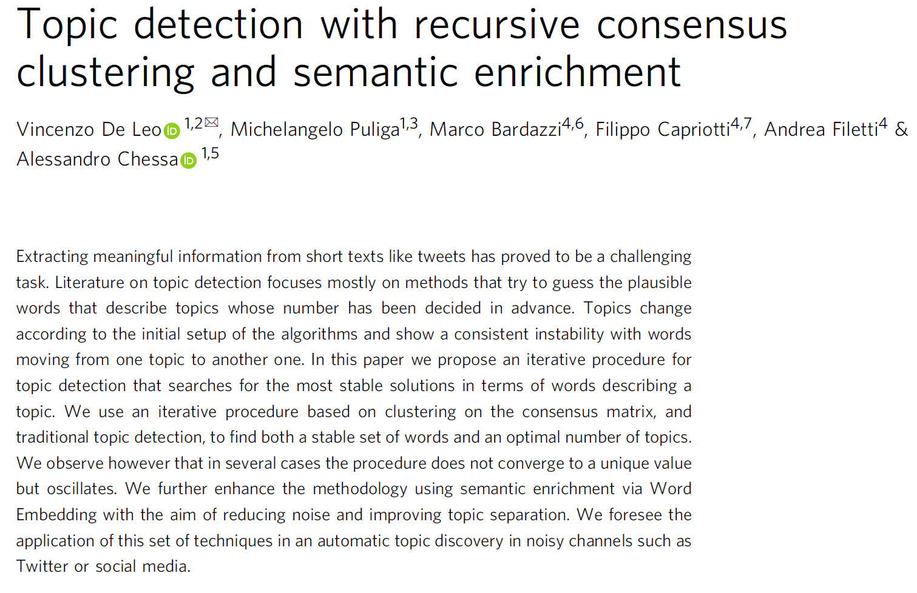
Notes:
The first paper described is centered around the tweets and the problems that occur in analyzing their content. It attempts to provide a topic-detection methodology that works fine for short texts, of 120 or 240 words.

Slide 7
Challenges
Tweets are short texts, that yield only a little information.
Additionally they contain lots of noise.
It is hard to find the proper number of clusters/topics.
Clustering/topic detection methods provide unstable clusters.
Contributions
Introduction of the stable clustering method.
Semantical enrichment of short texts.
Notes:
This task is not easy and the authors outline 4 major challenges. (READ SLIDE)
In order to answer the aforementioned issues they (READ SLIDE)

Slide 8
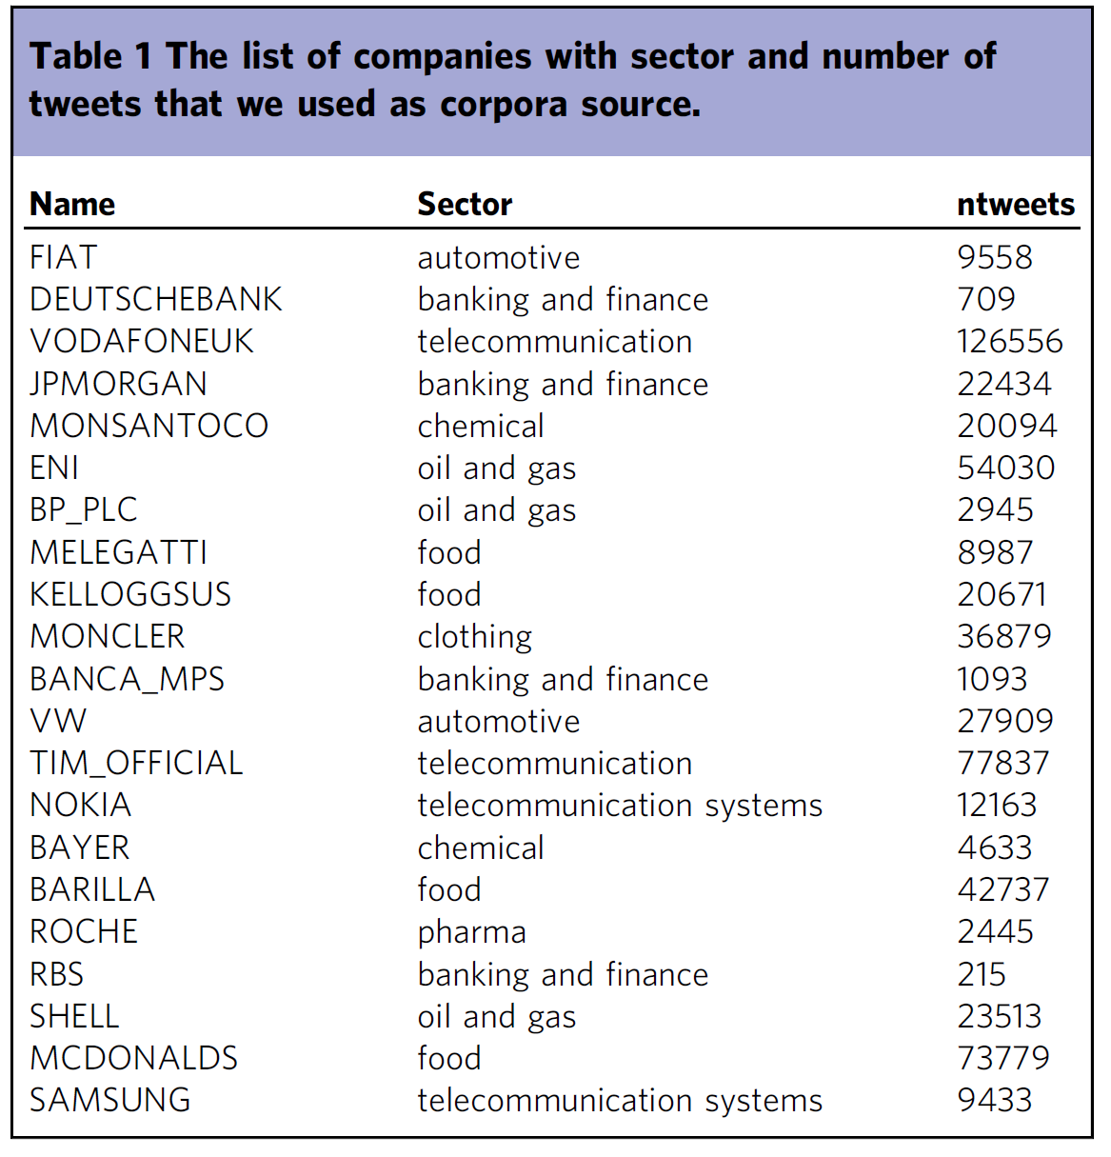
Dataset preparation
Filtering tweets by 20 popular companies (~500 000 tweets ).
Preprocessing in Python with NLTK package:
Language identification with LangID (English),
Lower-casing,
Tokenization,
Removal of mentions, links, and hashtags,
Removal of stopwords, and punctuation.

Slide 9
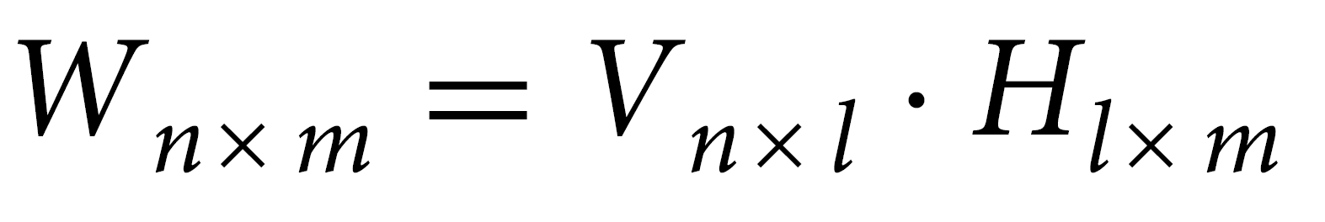
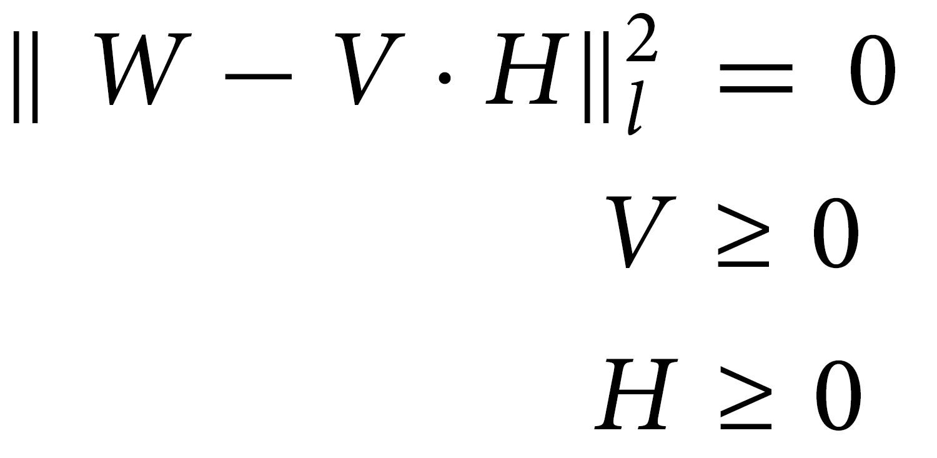
Non-Negative Matrix Factorization
Notes:
To understand their final solution we have to know what NMF is.
Non-Negative Matrix Factorization (NMF) is a technique for analyzing large datasets by decomposing them into smaller, more manageable components.
Let be W a matrix of nxm that, in the domain of text analysis, represents a tf-idf matrix where n is the number of documents and m is the corresponding size of the dictionary (the set of all distinct words present in the document). Usually, W is a sparse and large matrix, to be decomposed into two matrices V and H, with the former being the document-topic matrix and the latter representing the topic-words matrix.
Each topic in H is associated with the frequencies of the m words in the dictionary. To solve the first equation a recursive technique based on the following Frobenius norm
Finally from the recovered topic-words matrix H we can select per each of the l rows (the topics) a subset of words m* < m according to their weights, and use it to represent the m* most important words of each topic.
So, shortly: In the context of topic detection in Twitter data, NMF can be used to identify the main themes or topics that are being discussed.

Slide 10
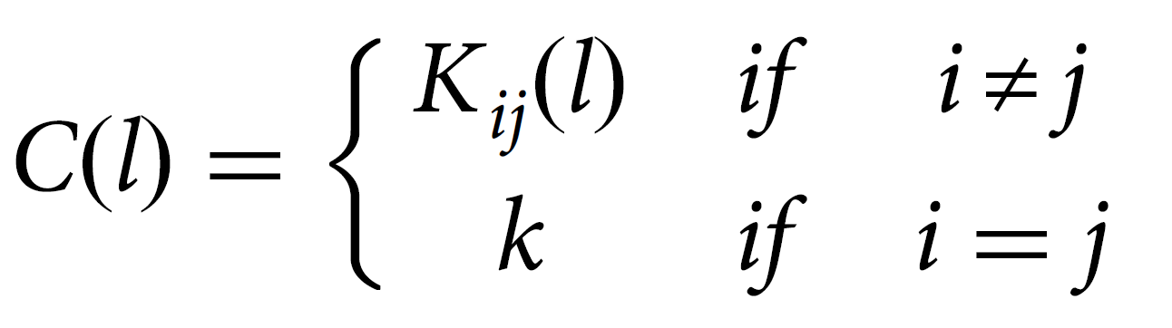
Consensus clustering
Notes:
Now, we can shortly describe the main contribution of this work being the consensus clustering.
The idea behind consensus clustering is that by repeating the clustering operation many Times with varying NMF regularization parameters, the words that will stay most of the time in the same cluster are likely to be the correct cluster members
We compute the consensus matrix C(l, ) of l topics and k runs in the following way: where Kij(l) ≤ k is the number of co-occurrences of the pair formed by the word hs(k) and the word ht(k) in all the k runs of the NMF decompositions when the regularization parameters are varied for fixed l. In other words, the consensus matrix counts how many times a pair of words is present in the same topic when the regularization parameters of the NMF decomposition are varied. We call the entries of the C matrix with the name hits.
The consensus matrix will show higher entries for those words that appear more frequently together in the same topic. Clustering the consensus matrix can be used as a filtering tool for topics, saving only the most stable words that stay in a topic.
Finally, To avoid selecting by hand the optimal number of clusters in the K matrix the authors used the HDBSCAN algorithm.

Slide 11
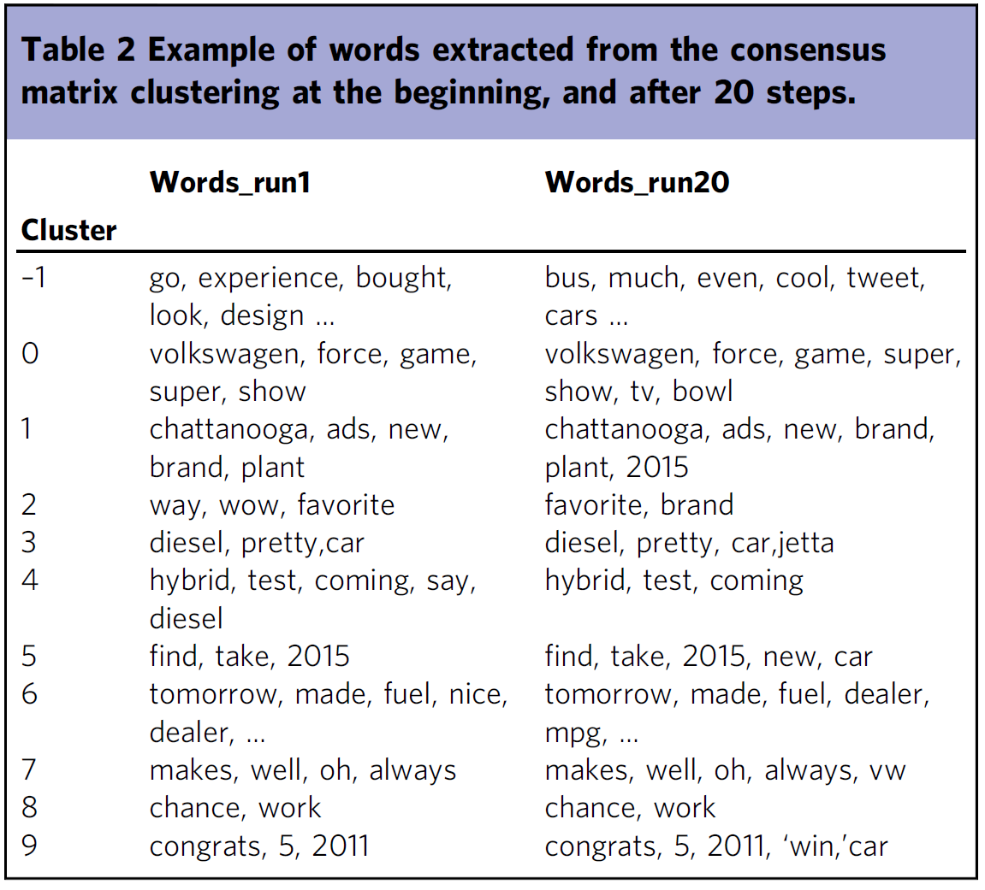
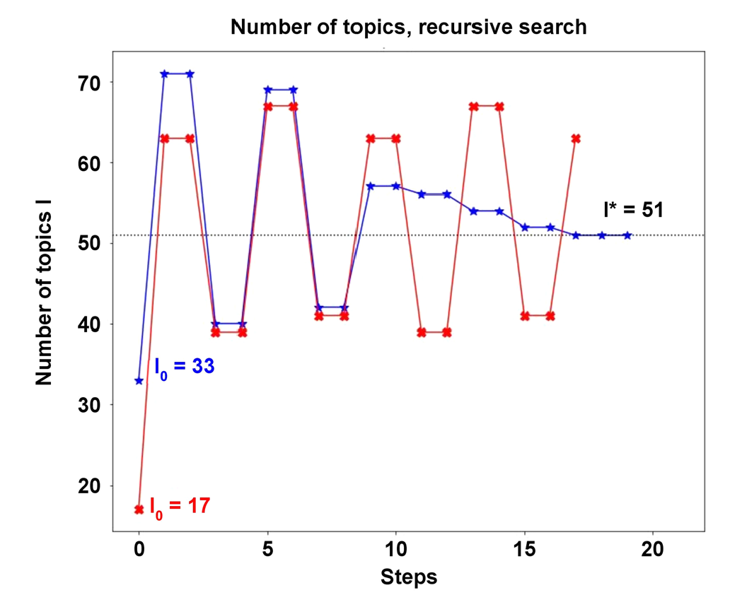
Results
Notes:
Now let’s move to the results.
On the left, we can see two scenarios of how the clustering process might go. The blue line shows an example with convergence of topic number, whereas the red one oscillates and does not converge.
The more important part is, however, the table on the right. It shows us the most important word from each cluster in the first iteration of the algorithm and the 20th. We can see that the words are fairly the same, which shows us that the clustering is indeed stable.

Slide 12
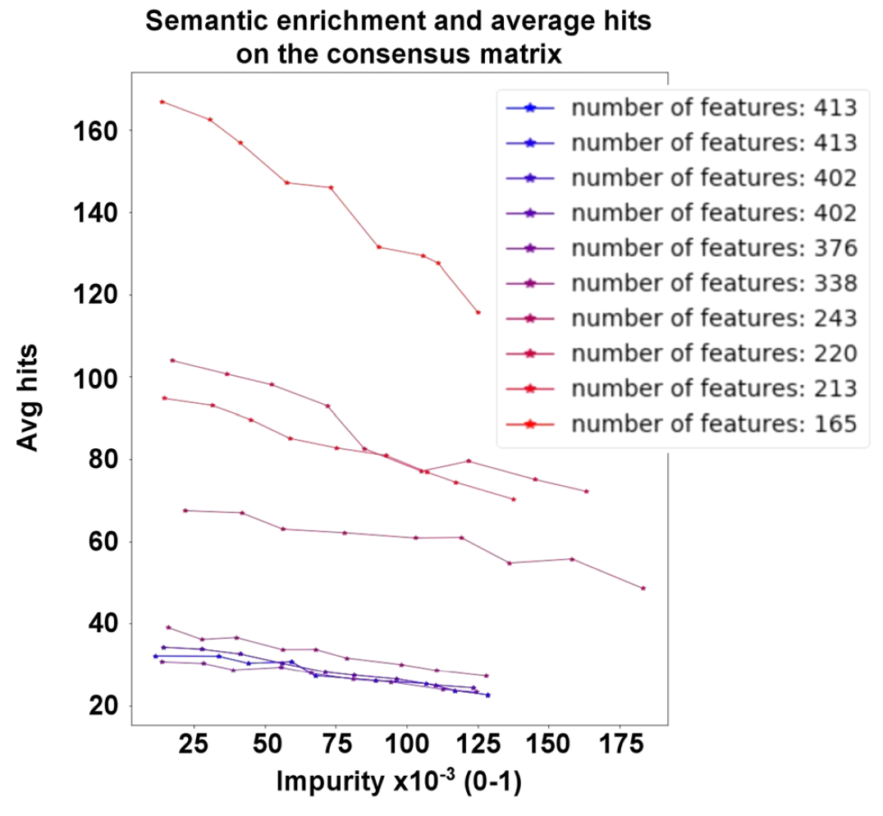
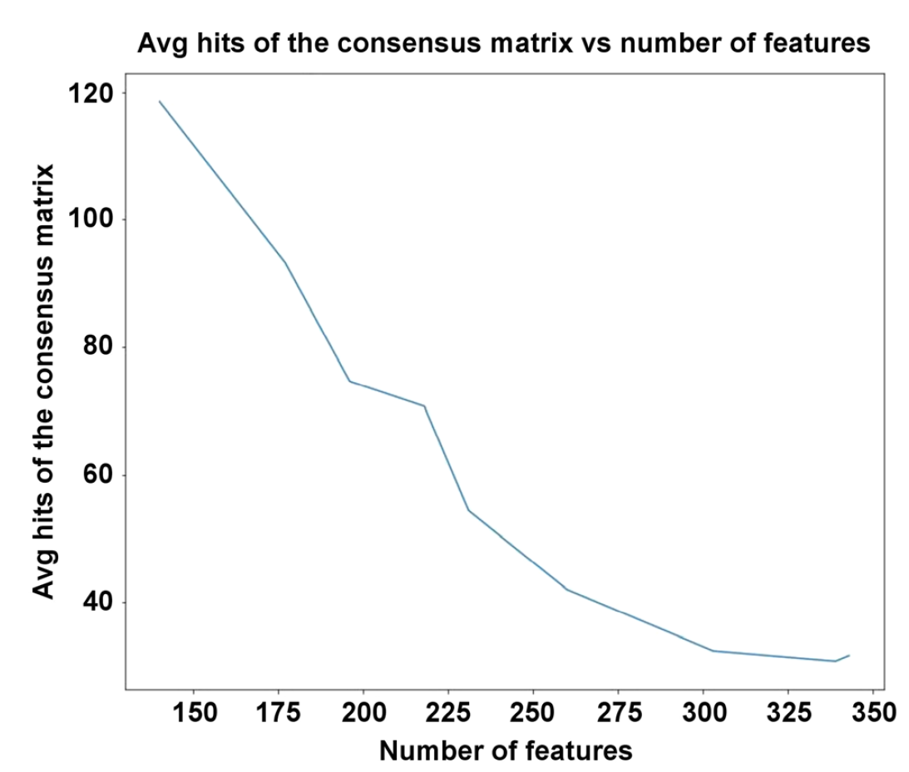
Results
Notes:
Additionally, reacher corpora result in a smaller number of features, which means that they are more specialized and stay on topic.
The last experiments considered the semantic enrichment of the corpora. The authors chose random tweets, and from them chose randomly a set of proper words, such as nouns, verbs, or adjectives. After that, they used a pre-trained word2Vec to generate semantically similar words and added them to the corpus.
As seen on the right plot, regardless of the initial number of features, introducing higher impurity, being the fraction of artificially generated corpus resulted in smaller average hits, which leads to more specific topics.

Slide 13
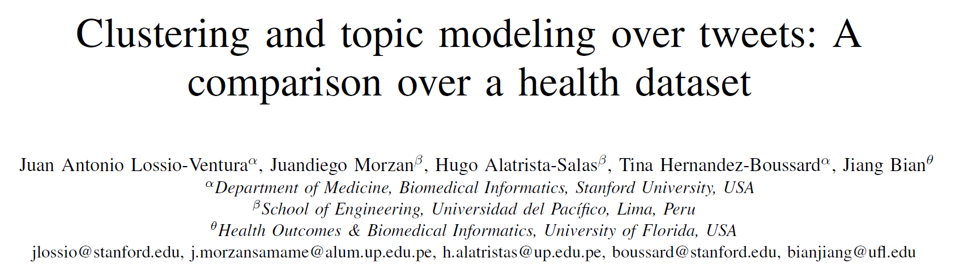
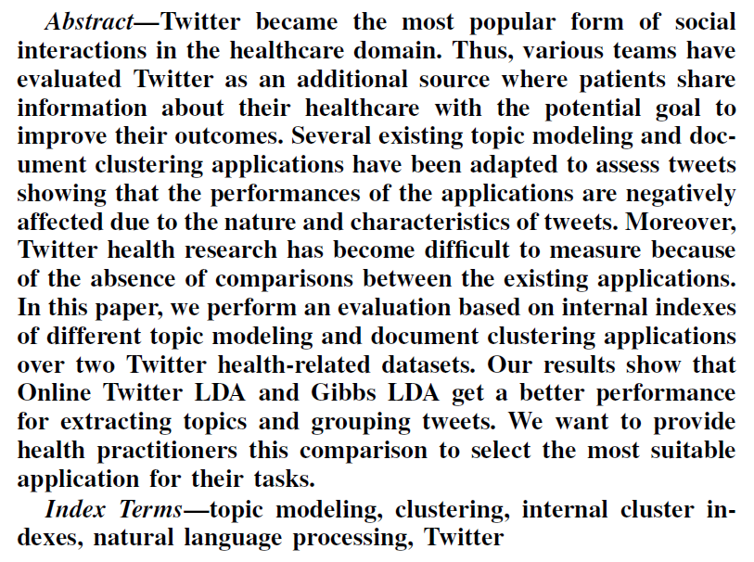
Notes:
The second paper also uses tweets in order to outline topics present in the data, yet they focus much more on the comparison of various topic detection methods. Additionally, this time used data is not so random, as the authors with medical backgrounds, focus on this field in order to obtain interesting results.

Slide 14
Challenges
Tweets contain lots of noise, and not all users are reliable.
Lack of ground truth information (labels).
It is hard to find the proper number of clusters/topics.
Contributions
Comparison between numerous topic modeling and clustering algorithms.
Comparison of different dataset representation quality.
Example of how to evaluate clustering quality.
Notes:
The challenges in this paper are quite similar to the previous one. READ

Slide 15
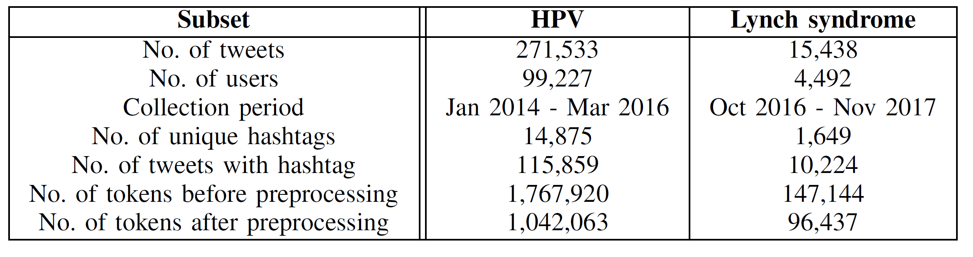
Dataset preparation
Obtaining tweets related to HPV, and Lynch syndrome diseases, by hashtags.
Preprocessing of tweets:
Lowercasing the text,
Removal of repeated tweets,
Removal of stop-words,
Removal of links.

Slide 16
Tested methods
Topic modeling approaches:
Latent Semantic Indexing (LSI),
Latent Dirichlet Allocation (LDA),
LDA with Gibbs Sampling (GibbsLDA),
Online LDA,
Biterm (BTM),
Online Twitter LDA.
Clustering approaches:
K-means with TFIDF representation,
K-means with Doc2Vec representation.

Slide 17
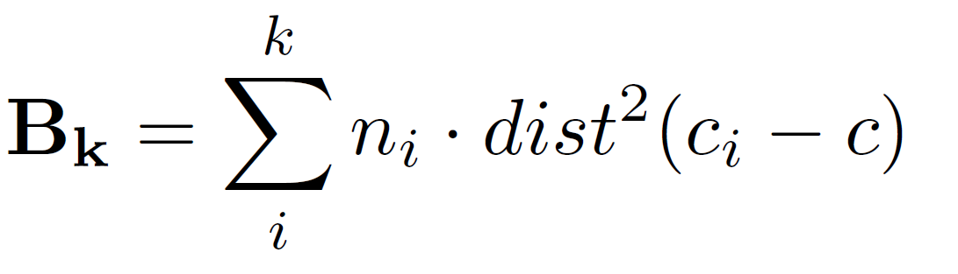
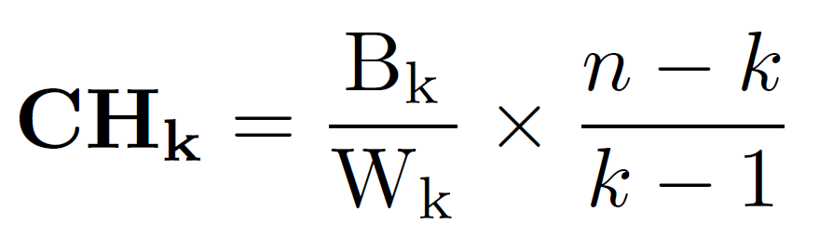
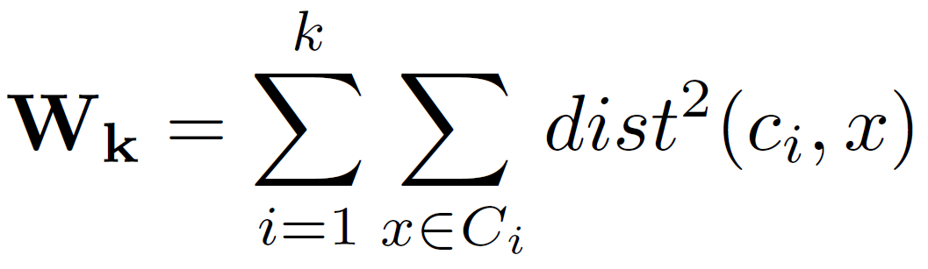
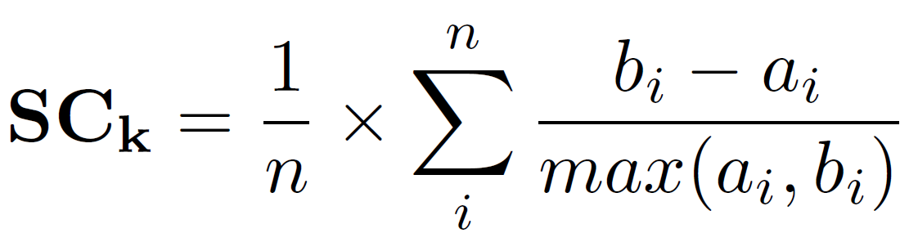
Evaluation metrics
Calinski-Harabasz index (CH):
Silhoutette Coefficient (SC):
Notes:
The aforementioned methods will be evaluated with two metrics. The first one is the Calinski Harabsz index. Its value is given by the ratio between the average inter-cluster dispersion matrix (Bk) and intra-cluster dispersion matrix (Wk). The Bk is based on the distance between clusters, whereas Wk is based on the distance within clusters. The maximum value of CH indicates a suitable partition for the dataset, and of course, the higher it is, the better.
The second Metric called the Silhouette Coefficient is well-known to us from the AdvancedML course. Just, as a reminder it studies the separation distance between the resulting clusters, and its values range from -1 to 1, where 1 is good, and -1 is poor.

Slide 18
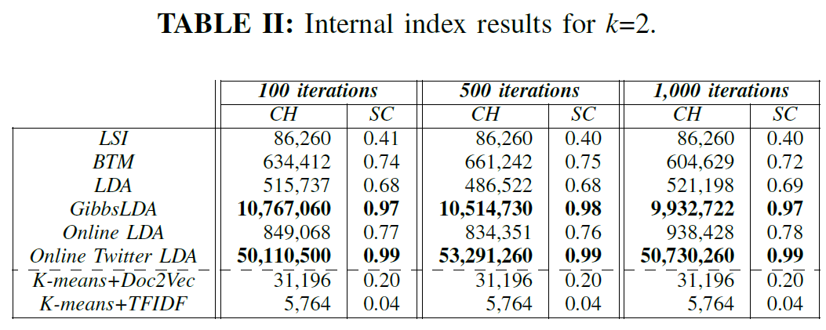
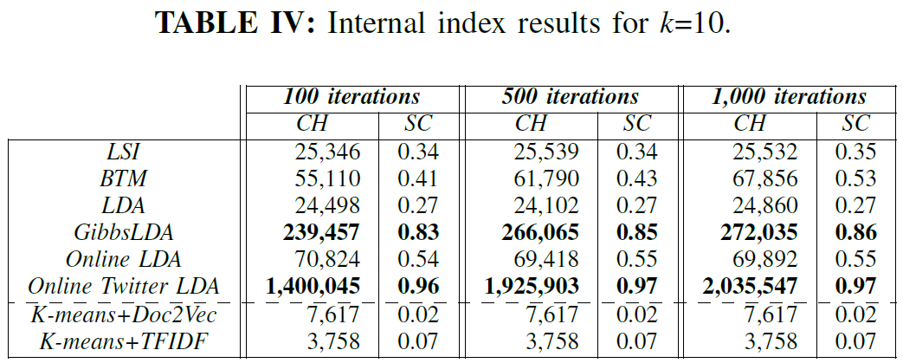
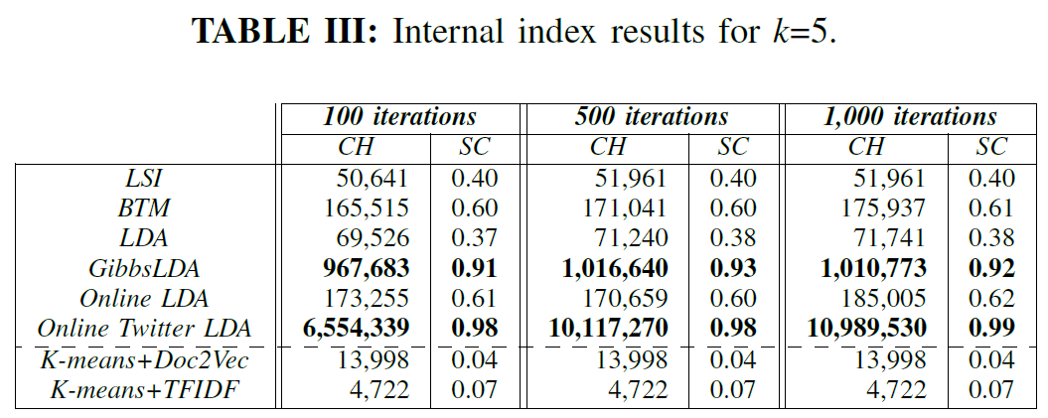
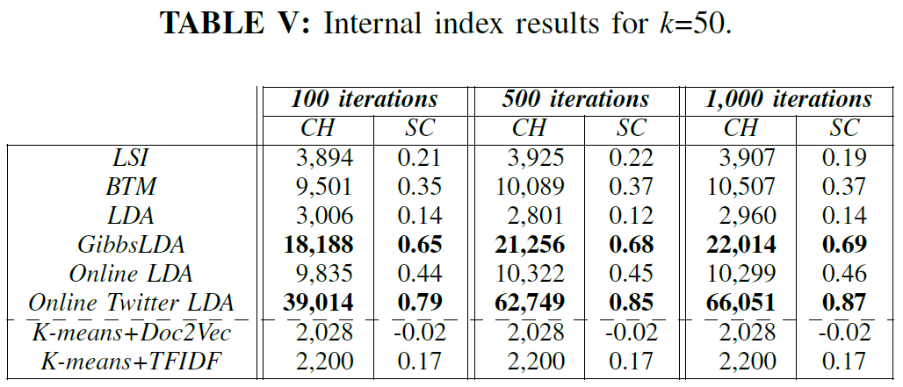
Results
Notes:
The authors evaluated each algorithm for a different number of clusters equal 2, 5, 10, or 50, and three iterations horizons of 100, 500, and 1000. As we can see, for each approach the best method was definitely Online Twitter LDA, but a close second was the GibbsLDA. Additionally, the scores tend to worsen the bigger the number of clusters is. It is not surprising, as we used two sets of tweets, describing different illnesses.

Slide 19
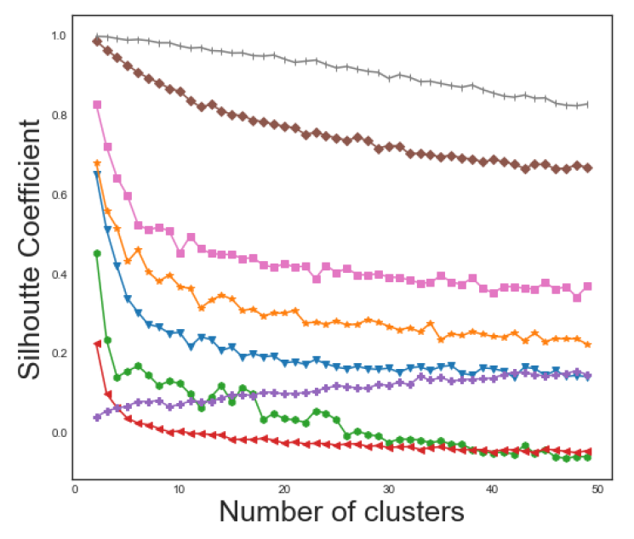
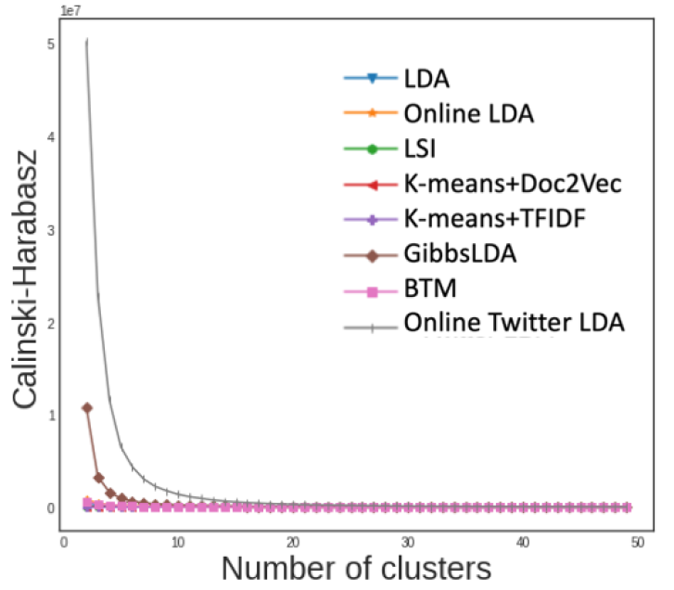
Results
Notes:
This observation holds for plots presented on this slide. We can see that at the beginning all scores are much higher than for more clusters.
Moreover, we can focus on The red and purple lines describing K-means with doc2vec, and TFIDF. Interestingly, we can see that although the doc2vec representation yields a better maximum value of silhouette coefficient, the TFIDF is the only curve, that benefits from a larger number of clusters.
Finally, we can witness that clustering algorithms are not as effective as proper topic detection methods.

Slide 20
03
Fake News Detection
Improving Fake News Detection Using K-means and Support Vector Machine Approaches
Fake News Detection using Machine Learning with Feature Selection

Slide 21
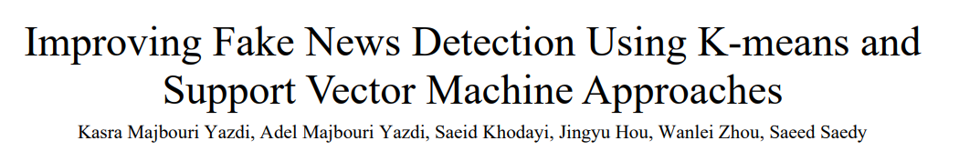
Fake news and false information are big challenges of all types of media, especially social media. There is a lot of false information, fake likes, views and duplicated accounts as big social networks such as Facebook and Twitter admitted. Most information appearing on social media is doubtful and in some cases misleading. They need to be detected as soon as possible to avoid a negative impact on society. The dimensions of the fake news datasets are growing rapidly, so to obtain a better result of detecting false information with less computation time and complexity, the dimensions need to be reduced. One of the best techniques of reducing data size is using feature selection method. The aim of this technique is to choose a feature subset from the original set to improve the classification performance. In this paper, a feature selection method is proposed with the integration of K-means clustering and Support Vector Machine (SVM) approaches which work in four steps. First, the similarities between all features are calculated. Then, features are divided into several clusters. Next, the final feature set is selected from all clusters, and finally, fake news is classified based on the final feature subset using the SVM method. The proposed method was evaluated by comparing its performance with other state-of-the-art methods on several specific benchmark datasets and the outcome showed a better classification of false information for our work. The detection performance was improved in two aspects. On the one hand, the detection runtime process decreased, and on the other hand, the classification accuracy increased because of the elimination of redundant features and the reduction of datasets dimensions.

Slide 22
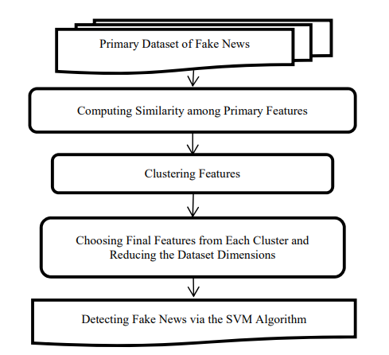
Proposed method

Slide 23
Dataset
Obtaining tweets related to HPV, and Lynch syndrome diseases, by hashtags.
Preprocessing of tweets:
Lowercasing the text,
Removal of repeated tweets,
Removal of stop-words,
Removal of links.

Slide 25
Challenges
Tweets contain lots of noise, and not all users are reliable.
Lack of ground truth information (labels).
It is hard to find the proper number of clusters/topics.
Contributions
Comparison between numerous topic modeling and clustering algorithms.
Comparison of different dataset representation quality.
Example of how to evaluate clustering quality.

Slide 27
Challenges
Tweets contain lots of noise, and not all users are reliable.
Lack of ground truth information (labels).
It is hard to find the proper number of clusters/topics.
Contributions
Comparison between numerous topic modeling and clustering algorithms.
Comparison of different dataset representation quality.
Example of how to evaluate clustering quality.

Slide 28
04
Explainability
A systematic survey on explainable AI applied to fake news detection
Towards Machine Learning Explainability in Text Classification for Fake News Detection

Slide 30
Challenges
Tweets contain lots of noise, and not all users are reliable.
Lack of ground truth information (labels).
It is hard to find the proper number of clusters/topics.
Contributions
Comparison between numerous topic modeling and clustering algorithms.
Comparison of different dataset representation quality.
Example of how to evaluate clustering quality.

Slide 32
Challenges
Tweets contain lots of noise, and not all users are reliable.
Lack of ground truth information (labels).
It is hard to find the proper number of clusters/topics.
Contributions
Comparison between numerous topic modeling and clustering algorithms.
Comparison of different dataset representation quality.
Example of how to evaluate clustering quality.

Slide 33
Thank you for your attention!

